Slide 1
Pensions and Retirement Income
Presentation to PBCO, TBF, GOA
Paul E. Owens
Senior Vice-President, Pension Policy
Ellement Consulting Group
May 17, 2023

Slide 2
Outline
Pensions – Introduction and History
The Pension Landscape
Canada
Alberta
World
Retirement Savings – The $ and #
Pensions – Liabilities and Benefits
Pensions – Assets and Investments
Conclusions and Take-Aways

Slide 3
1. Pensions – Introduction and History
What is a Pension?
Income replacement after Retirement [usually paid monthly]
What is Retirement?
Period of time after work stops and before you die
Historically, you worked until you _____________
Pensions started mid/late 1800’s
What was your income support system when you got old?
Your_________
Agricultural society

Slide 4
1. Pensions – Introduction and History
Lots of Children… Why?
Mortality - little change for 2000 years: 35-45
Causes:
High infant mortality --- “Wash your hands”
Diseases/Plague/Epidemics/Flu
Warfare
Starvation

Slide 5
1. Pensions – Introduction and History
Advances in medicine in 1800’s --- lower mortality
Result: What to do with now “unproductive” old people
Solution: provide a pension [from state or employer]
State pensions:
1889 Germany/ Bismarck
1908 U.K
Employer: Rome – Legionnaires after 25 years of service: got plot of land
Canada:
Hudson’s Bay Company – discretionary
Grand Trunk Railway
Banks
Federal Government

Slide 6
1. Pensions – Introduction and History
Paying for Pensions [Funding]:
A. Pay As You Go -- no pre-funding
E.G: Old Age Security – paid out of current tax revenues
B. Pre-funded – set aside funds when working to pay pensions in retirement
E.G: Employer plans
UAPP
PSPP
Imperial Oil
C.P.R.
C. Partially Funded – some reserves
E.G: Social Security Systems
Canada Pension Plan
Quebec Pension Plan
U.S. Social Security System

Slide 7
1. Pensions – Introduction and History
Original Design Model: up to about 1970’s
Hired: Age 25
Retired: Age 65 [all with 1 employer]
Died: Age 75
Contributions: Paid in over 40 years
Benefits: Paid out over 10 years
Ratio: 4:1

Slide 8
1. Pensions – Introduction and History
Current Model: post 1980 +/-
Hired: Age 25 +/-
Retired: Age 55-60 [ with many employers/careers]
Died: Age 90
Contributions: Paid in over 35 years --at best
Benefits: Paid out 30 -35 years
Ratio: 1.17:1 [Ontario Teachers: 26 years working: 32 years retired = .81:1]
Cost per unit of benefit goes _________?

Slide 9
2. The Pension Landscape – Canada
Country Canada U.S.
Population 39 Million 331 Million
# of Provinces/States 10 50
# of Private Sector Pension Acts 10 1

Slide 10
2. The Pension Landscape – Canada
# of Pension Plans: 16,359 [3% decline since 2016]
# Active Members: 6,593,000 [5% increase since 2016]
Decline in Pension Coverage: 1989 2021*
% of Employed Labour Force: 43% 40%
% of Public Sector Labour Force: 83% 90%
% of Private Sector Labour Force: 31% 24%
* up from 2019 due to decrease in workforce from COVID

Slide 11
2. The Pension Landscape – Canada
Decline in Defined Benefit
Pension Coverage as % of Active Members: 1989 2021
% of All Active Members: 90% 67%
% of Public Sector Active Members: 98% 91%
% of Private Sector Active Members: 85% 40%

Slide 12
2. The Pension Landscape – Canada
Private Sector Pension Coverage as
% of Employed Labour Force 1989 2021
Defined Benefit Plans: 27% 10%
Defined Contribution Plans: 3% 8%
Hybrid Plans: 1% 6%
Total: 31% 24%
Group Registered Retirement Savings Plans: 12% (est) 15%
Grand Total: 43% 39%

Slide 13
2. The Pension Landscape – Canada
Retirement Income Assets – 2022 Billions
$CAD
Canada Pension Plan 536
Quebec Pension Plan 88
Total Social Security 624
Employer Pension Plans 2,244
RRSP’s 1,450
TOTAL 4,318

Slide 14
2. The Pension Landscape – Canada Maple 8
Plan/Fund Single Plan? Assets - Billions
$CAD
1. CPPIB Yes 536
2. CDPQ No 402
3. OTPP Yes 247
4. PSPP No 230
5. BCI No 211
6. AIMCo No 135
7. OMERS Yes 126
8. HOOPP Yes 104

Slide 15
2. The Pension Landscape – Alberta

Slide 16
2. The Pension Landscape – Alberta

Slide 17
2. The Pension Landscape – World $ U. S
1. Japan Govt. Pension ($1.7T)
4. US Federal Thrift Savings Plan ($650B)​
5. Netherlands ABP ($610B) ​
7. California Public Employees ($430B)
​8. Canada Pension ($390B)
15. NYC Retirement ($230B) ​
24. Boeing $130B (half DB, half DC)
*Source: Pensions & Investments (P&I) (12/31/20)​
​

Slide 18
3. Retirement Savings – The $ and #
Conventional Wisdom
Goal - Maintain pre-retirement standard of living during retirement
Metric - Pension = 70% of pre-retirement after-tax income
Why not 100%?
House paid off
No more work- related expenses [ commute/parking/meals/clothing]
No CPP/EI/Pension Contributions/Retirement Savings
Children have left home
Now receive CPP/OAS benefits
Pension and age tax credits

Slide 19
3. Retirement Savings – The $ and #
New Paradigm:
70% target is too high
Individual range: 40%-80%
Rent vs own house
Urban vs rural
Old assumption of employer pension for full career no longer valid

Slide 20
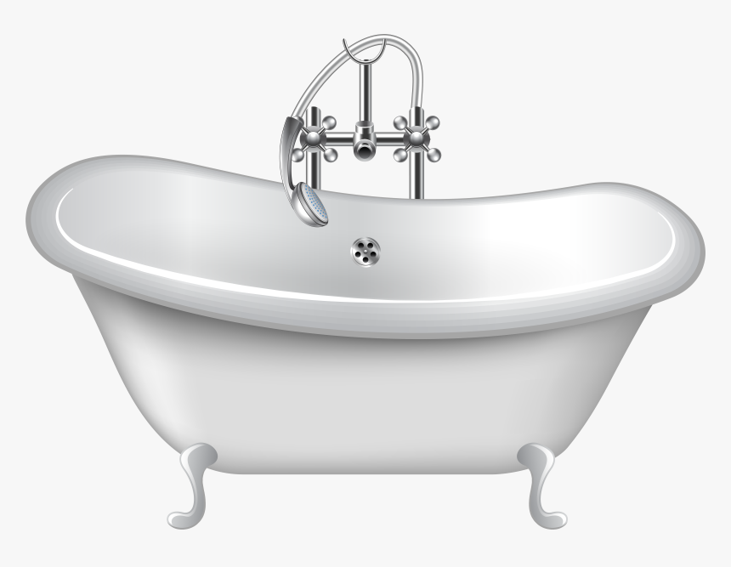
3. Retirement Savings – The $ and #
The Pension Bathtub
Objective:
Keep enough funds in the tub to pay pensions
Contributions - In
Investment Income - In
Pensions - Out
Expenses - Out [0.10% -2.50% of assets]

Slide 21
3. Retirement Savings – The $ and #
How long can a pension be paid?
For life of member, surviving spouse, dependent children
Record for pension payment
Service started 1862
Service ended 1865
Last recipient died 2020 [158 years from start of service]
U. S. Civil War Veteran
Married late in life [2nd marriage]
Young wife
Disabled child

Slide 22
3. Retirement Savings – The $ and #
“ I can live off CPP and OAS”
Canada Pension Plan - 25%-33% of earnings up to Year’s Maximum Pensionable Earnings [YMPE] of $66,600
Old Age Security - flat amount [ “clawed back for high income”]
Guaranteed Income Supplement [GIS] – income based supplement

Slide 23
3. Retirement Savings – The $ and #
“ I can live off CPP and OAS”
Age: 60 65 70
CPP: $10,034 $15,679 $22,264
OAS: N/A $8,251 $11,221
GIS: N/A $2,579 $ 0
Total: $10,034 $26,509 $33,485
Income Replacement as % of YMPE: 15% 40% 50%

Slide 24
3. Retirement Savings – The $ and #
The Mathematics:
Your Pre-Retirement Gross Income
A. $______
2. Your Post-Retirement Income Objective
B. %_______
3. Your Post-Retirement Income
C. $_______ (A. x B.)
4. CPP $_______
OAS $_______
D. $_______ (CPP+OAS)
5. Pension and Other Income
E. $_______
Annual Savings to be Funded
F. $_______ (C – D – E)

Slide 25
3. Retirement Savings – The $ and #
The Mathematics: How do we fund for “F”
Assumption dependent:
1. Age at death
2. Age payments commence
3. Age savings start
4. Rate of Return on Investments
5. Years of Payments
6. Years of Contributions

Slide 26
3. Retirement Savings – The $ and #
The Mathematics:
Your Pre-Retirement Gross Income
A. $66,600
2. Your Post-Retirement Income Objective
B. 70%
3. Your Post-Retirement Income
C. $46,620 (A. x B.)
4. CPP $15,679
OAS $8,251
D. $23,930 (CPP+OAS)
5. Pension and Other Income
E. $0
Annual Savings to be Funded
F. $22,690 (C – D – E)

Slide 27
3. Retirement Savings – The $ and #
The Mathematics: How do we fund for “F”
Assumption dependent:
1. Age at death – 90
2. Age payments commence – 65
3. Age savings start – 25
4. Rate of Return on Investments – 5%
5. Years of Payments – 25
6. Years of Contributions – 40

Slide 28
3. Retirement Savings – The $ and #
The Mathematics: How do we fund for “F”
Step 1.
Determine Present Value at age 65 of future annual payments of $22,690 payable for 25 years:
= $22,690 x 14.09* = G. $ 319,702
* Present Worth of 1 Per Period @ 5% for 25 years
Step2.
Determine Annual Contribution from age 25-65 required to produce G:
= G. $ 319,702 x .008278** = H. $ 2,646
** Sinking Fund @ 5% for 40 years
Conclusion: If you contribute $2,646 per year from age 25 -65, you will have enough to pay $22,690 from 65-90

Slide 29
3. Retirement Savings – The $ and #
The Mathematics: How do we fund for “F”
Note:
Change any variable, results change.
E.G.:
Change retirement age from 65 to 60
30 years of payout and 35 years of contributions
G. = $348,791 -- 9% more
H. = $3,862 --46% higher

Slide 30
4. Pensions – Liabilities and Benefits
Pension liabilities:
What the pensions [in pay or accrued]are worth today
Defined Benefit [DB] vs. Defined Contribution [DC]
DB: assets need to = liabilities [contributions = whatever it takes to fund
liabilities]
DC: Contributions defined. Benefit = Value today of contributions + investment earnings
Risk in DB plan:
Assets not enough to pay promised benefits
Risk in DC plan:
Pension not enough to support lifestyle

Slide 31
4. Pensions – Liabilities and Benefits
Who bears risk?
Risk | DB | DC
Investment returns | Employer | Member
Mortality | Employer | Member
Interest Rate | Employer | N/A

Slide 32
4. Pensions – Liabilities and Benefits
Types of Plans:
A. Defined Contribution
Note: Maximum Total Contributions: 18% [Income Tax Act]
Minimum ER Contribution: 1% [Income Tax Act]
Examples | EE Contribution | ER Contribution
1. ER paid | 0% | 5%
2. Cost shared | 5% | 5%
3. Matching | 0% - 9% | 1% - 9%

Slide 33
4. Pensions – Liabilities and Benefits
B. Defined Benefit
Note: Maximum Benefit: lesser of 2% x Highest 3- year average pay and $3,420 per year of
service [Income Tax Act]
Examples | EE Contribution | ER Contribution
1. ER paid | 0% | 100% of cost
2. Fixed EE | 5% | Balance of cost
3. Cost shared | 5% plus fund deficits | 5% plus fund deficits

Slide 34
4. Pensions – Liabilities and Benefits
C. Target Benefit Plan
Contributions Fixed/Defined
Benefit Pre-defined [Target]
Benefit reduced if assets < value of pensions
More common in multi-employer collectively bargained plans

Slide 35
5. Pensions – Assets and Investments
Start with big picture:
How much can you afford to lose?
How long do you have to pay back loss(es)?
Choice: “You can either sleep well or you can eat well”
Risk and return are highly correlated
Markets will not give you high returns and low risk
Risk is measured by standard deviation (variability) of returns
Return/ Risk = Information Ratio [IR]
Objective: High IR

Slide 36
5. Pensions – Assets and Investments
Top Down Process
1. Investment beliefs [ active vs passive, in-house vs. external, balanced vs specialty funds]
2. Statement of Investment Policies and Procedures [SIPP]
Return objectives and time frames
Benchmark reference [E.G.: S&P/TSX, S&P500]
Asset mix policy – target and ranges [ E.G.: 60% Equities +/- 10%]
Asset classes
Manager selection and monitoring
Rebalancing
Proxy voting

Slide 37
5. Pensions – Assets and Investments
Asset Class Returns and Standard Deviations
Asset Class Returns
Canadian Equities 7.6%
U.S Equities 11.2%
Foreign Equities (All) 6.9%
Foreign Equities (Developed) 7.5%
Canadian Bonds 0.2%
Real Estate 5.7%

Slide 38
6. Conclusions and Take-Aways
Pension system developed based on old models
Old models out of date
Develop new models
New models must recognize: many jobs/increasing longevity/many retirements/only periodic pension coverage
Retirement savings: start young and let time and compound interest work in your favour

